Slide 1

How to Start Narcan on Campus: A Practical Guide to Opioid Overdose Prevention in Educational Settings
Stephanie Rose, Associate Professor, Program Coordinator, DSW, LCSW, AADC, DCS, Addiction Studies and MS Pathway to Prevention, University of Central Arkansas

Slide 2
Naloxone on College Campuses: A Call to Action
Never stop advocating — your voice matters, and the right person will hear you. Don’t shy away from asking hard questions or having courageous conversations. Keep educating others about the stigma surrounding Naloxone and why compassion saves lives. Partner with fellow changemakers who share your passion and empower one another to make a difference. Know the laws that support your mission and use them as tools for change. Together, we can create safer, more informed campuses — one conversation at a time.

Slide 3

What are opioids?
Illicit drugs
Prescription drugs
Morphine
Codeine
Methadone
Oxycodone (OxyContin®, Percodan®, Percocet®)
Hydrocodone (Vicodin®, Lortab®, Norco®)
Fentanyl (Duragesic®, Fentora®)
Hydromorphone (Dilaudid®, Exalgo®)
Buprenorphine (Subutex®, Suboxone®)
Fentanyl (Synthetic)
Heroin
Opioids are narcotic sedatives that depress the central nervous system.

Slide 4
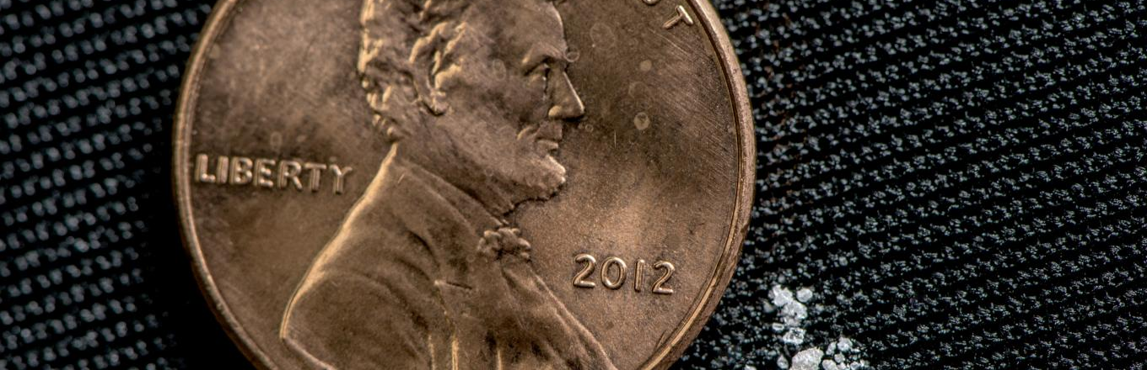
Synthetic opioids are dangerous and deadly
This amount of fentanyl can cause dizziness, nausea, and other signs of overdose in anyone who comes in contact with the drug.
Fentanyl is a powerful, synthetic opioid analgesic that is similar to morphine but is 50 to 100 times more potent.
Carfentanil has a potency approximately 10,000 times that of morphine and 100 times that of fentanyl.
Liquid Fentanyl
Notes:
The powder next to the penny (2 milligrams) is a fatal dose of illicit fentanyl.

Slide 5
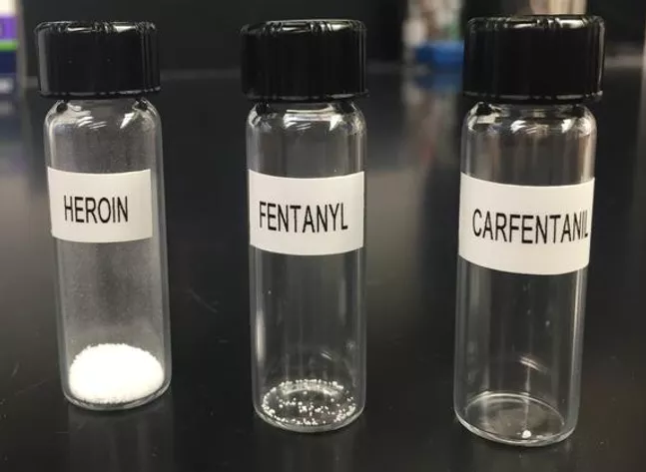
How much can cause an overdose?
This is an illustration of the amount of each substance that could cause an overdose.

Slide 6
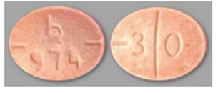
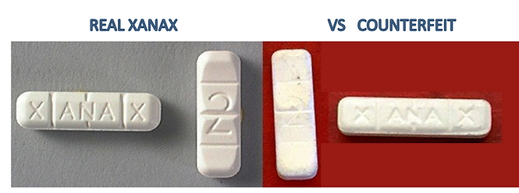
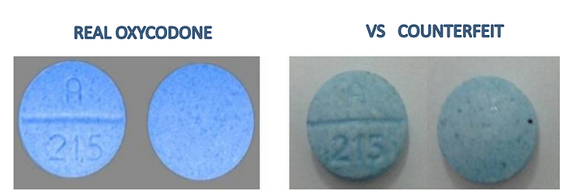
Press Pills-According to the DEA, 7 out of 10 pills are laced. Can you tell the difference?

Slide 7
How do people become addicted?
Dependence on prescription medication for existing pain.
Continuing medication after symptoms are gone.
Trauma, stress, peer pressure, exposure, and misinformation
Deliberately misusing a prescription opioid or an illicit drug like heroin.
Notes:
Addiction is a disease that can affect anybody and everybody, regardless of class or background.

Slide 8

What is Narcan?
NARCAN® is a drug used to reverse the effects of opioids.
NARCAN® is safe and effective with no risk of abuse.
NARCAN® has no effect on non-opioid overdoses.
NARCAN® CANNOT get you high.
NARCAN® is intended for rescue use, not long-term treatment.
Notes:
If you give Narcan to a person who is not overdosing, the only side effect would be a runny nose.

Slide 9
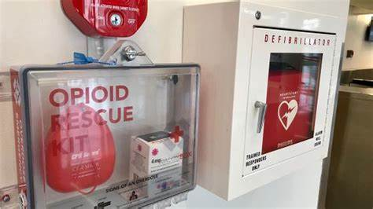
UCA Naloxbox Program
Started with 27 Naloxboxes were available in all UCA housing, now in every building with ACT 811.
This was done in collaboration with the AR Collegiate Network, The Arkansas Division of Aging, Adult & Behavioral Health Services, Midsouth and UCA!
Each box includes two, four mg doses of nasal Narcan, an instruction card, as well as a referral card for further treatment.

Slide 10
Act 811
Act 811 (Arkansas) is a law passed in 2023 that aims to increase access to opioid-overdose rescue kits on school campuses.
It required that by January 1, 2024, each public high-school and college campus in Arkansas have an opioid-overdose rescue kit (e.g., using naloxone) that is clearly visible and labelled.
Kits should be placed in locations similar to where Automated External Defibrillators (AEDs) are located (so that the public can readily access them).
The law is intended also to encourage schools to develop protocols regarding storage and use of the kits, and to train relevant staff. It is in EVERY building on campus!

Slide 11
Act 811 intent
The law acknowledges that overdose incidents can happen on campus and that rapid access to naloxone can save lives.
By aligning the rescue kit locations with existing emergency equipment (like AEDs), the goal is to make response more efficient and familiar.
The law pushes beyond carrying naloxone in a nurse’s office to ensuring public campus-wide access.
It helps normalize overdose response and reduce stigma by treating opioid reversal kits similarly to other lifesaving equipment.

Slide 12
A little about how we got started…
Advocacy-never stopped asking and talking, despite opposition.
Know your facts-data shows the rates of overdoses and types of lethal substances coming to your State and in the Nation.
Educate people about what Naloxone is and how many people do not realize they are ingesting Fentanyl.
Know what funding is available.
I was turned down several times until the right person heard me!
Service-learning project that led to Narcan.

Slide 13
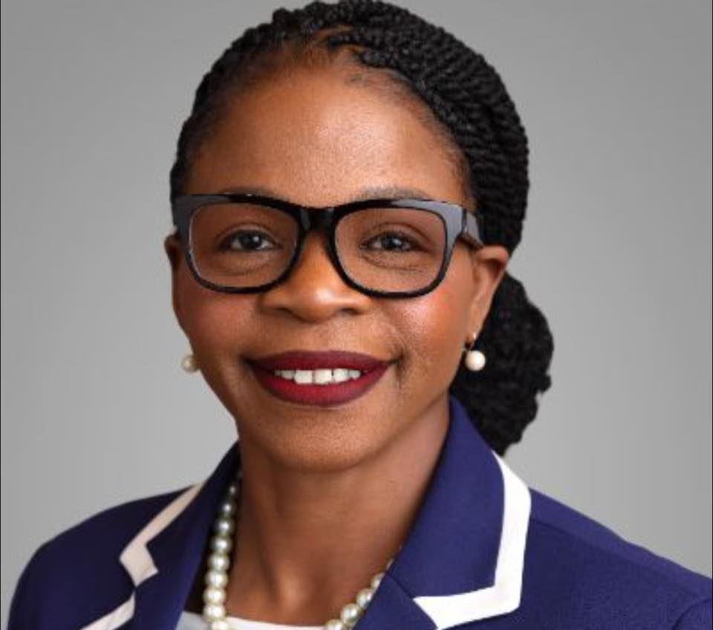
Our legislative champion
Representative Tara Shephard
Provided support and related facts to assist
Write legislatures about the importance of this
Efforts to pass this at the Federal Level

Slide 14
Current Illinois Laws and Resources
Illinois has a statewide standing order (sometimes called an “opioid-overdose reversal agent standing order”) that allows eligible entities to provide naloxone without an individual physician prescription to someone requesting it to respond to a suspected opioid overdose.
Non-medical persons are legally allowed to administer naloxone in the event of an opioid overdose.
Insurance coverage: Illinois law requires that consumers with health insurance that covers prescription drugs have coverage for at least one opioid antagonist (which may include naloxone).

Slide 15
Current laws continued…
In January 2024, under Public Act 103-0348 (and related statutory changes), public and private schools in Illinois became required to keep a supply of an opioid antagonist on-hand, and the standing order was updated to explicitly include schools.
OEND Programs (Overdose Education & Naloxone Distribution): Non-pharmacy entities (e.g., law enforcement, health departments, treatment programs) can enroll with the state (Illinois DHS / Division of Substance Use Prevention & Recovery) to dispense under the standing order.
The standing order allows any requesting person (e.g., a friend, family member, community member) to obtain naloxone if the intent is to respond to an opioid overdose.

Slide 16
Applying for State resources…
Training & registration still required — simply wanting it doesn’t guarantee supply unless the entity is enrolled or complies.
If you’re working in a specific context (college campus, health center, student-organization), you might need to check local policy, internal protocols, whether your institution is registered as an Opioid Education/Naloxone Distribution or has a standing order coverage.

Slide 17
Emergency Medical Services Access Law (2012) of IL
The law states that a person who calls 911 or takes someone to the ER for an overdose will not be charged or prosecuted for certain felony possession offenses if the evidence was obtained as a result of that call.
Specifically, protections cover certain amounts of controlled substances, e.g., fewer than 3 grams of heroin, fewer than 3 grams of morphine, or fewer than 40 grams of prescription opioids.
The law protects the person who is overdosing (the victim) when someone else seeks help.
Additionally, a separate law (Drug Overdose Prevention Program Law (PA 096-0361, 2010)) makes it legal for non-medical persons to administer a reversal agent like Naloxone in an emergency.

Slide 18
Limitations
The law does not protect against all crimes. For example, if there is independent evidence of dealing/distribution, or the evidence wasn’t obtained because someone called for help, immunity may not apply.
The law focuses more on possession charges rather than guaranteeing immunity for all possible legal consequences (like probation violation, other offenses, etc.).
It encourages people to call for help in the event of an overdose without fear of automatic felony prosecution for certain possession offenses. Be transparent about teaching this!

Slide 19
What if I don’t want to work with….
The Heath Department
Naloxone Grant Recipients http://www.dhs.state.il.us/page.aspx? item=105980
Is there an easier way? Yes!!!!!!
It involves empowering students too!

Slide 20
End Overdose
End Overdose is a U.S.-based nonprofit organization (501(c)(3)) dedicated to preventing and ending deaths from drug-related overdoses.
Their mission: “To end drug-related overdose deaths through education, medical intervention, and public awareness.”
Their vision: “No one else has to die.”
Core activities: offering no-cost overdose prevention training, distributing naloxone (opioid-overdose reversal medication), and providing fentanyl test strips and other harm-reduction tools.

Slide 21
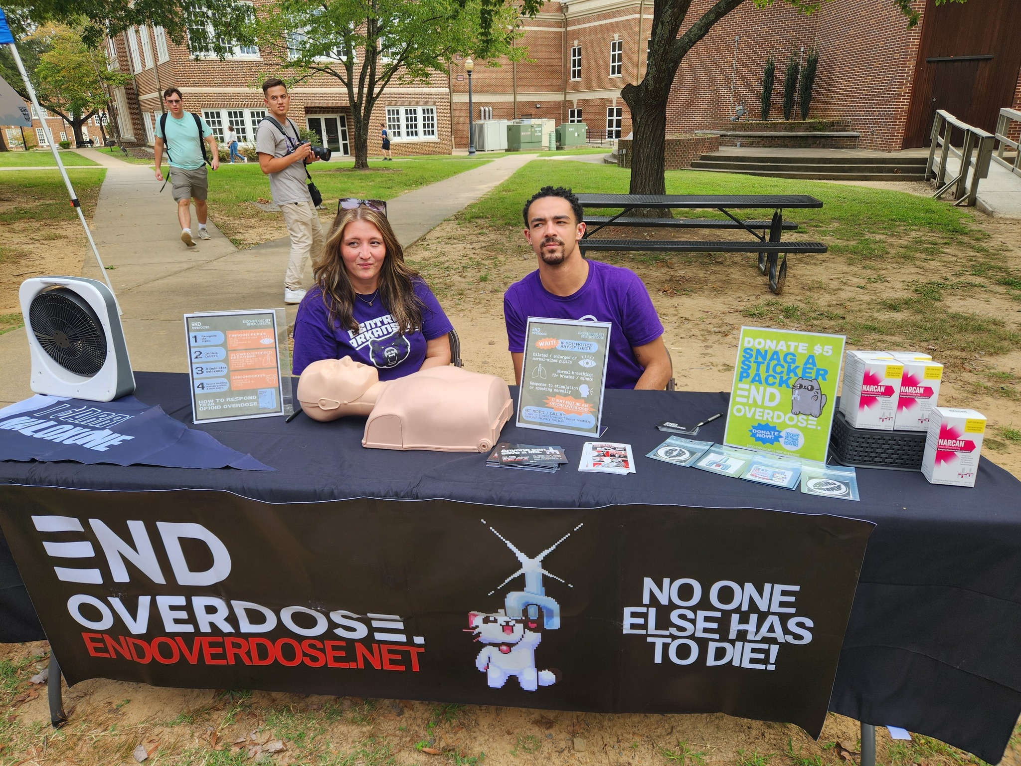
Our End Overdose Chapter!

Slide 22
End Overdose Chapters
There are no End Overdose Chapters in IL! DePaul had one…. https://endoverdose.net/about/chapters/
You can be the first!
Officially sponsored and supported branch of End Overdose, working closely with the End Overdose HQ. All Chapters must go through an application process and follow procedures setup by End Overdose.
Focused on overdose prevention and response
Supported by End Overdose HQ
Narrow focus

Slide 23
How does it work?
It works like an on-campus club. Identify students who want to be champions for this work on campus. There will be a President, VP, Secretary, Marketing and more positions for the Chapter.
Students will receive intensive, online training-both live and fun/engaging videos for the training.
You will have meetings with mentors.
The students can readily order hundreds of doses of free Naloxone to disseminate and train fellow students and even faculty/staff.
They will send you mock Naloxone, a CPR dummy, certification cards, test strips and more!

Slide 24
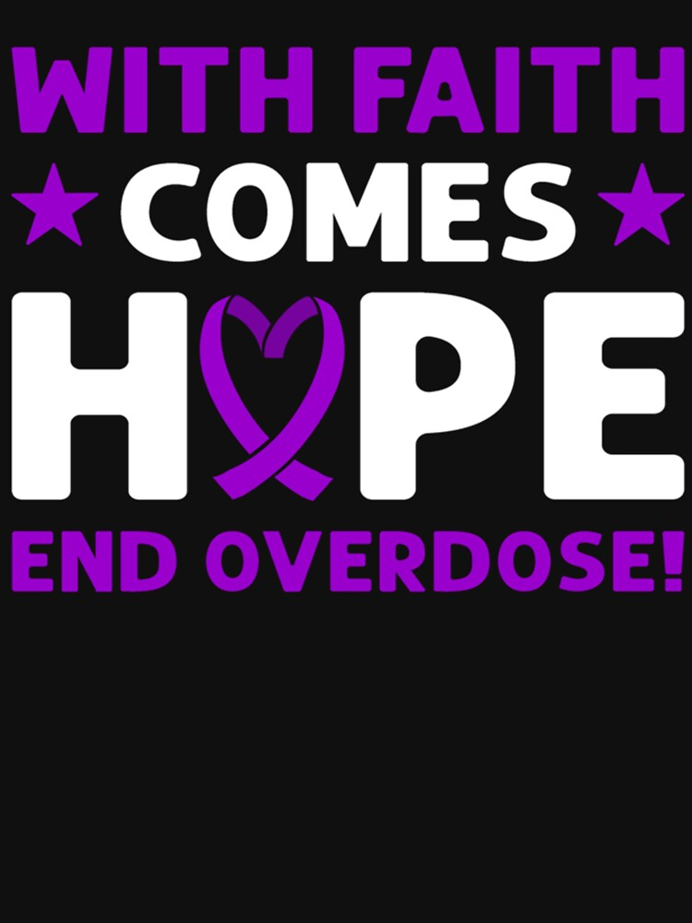
Resources
Free online courses: https://endoverdose.net/courses/
As students complete courses on various topics (about 20 minutes each), they can build points for fun rewards!
They will come to you if you request an event: https://docs.google.com/forms/d/e/1FAIpQLSd1FPhFfbRSoL6cHO4ObzxEGwWiBg6sTUybPAXLCMkdqjQHjg/viewform

Slide 25
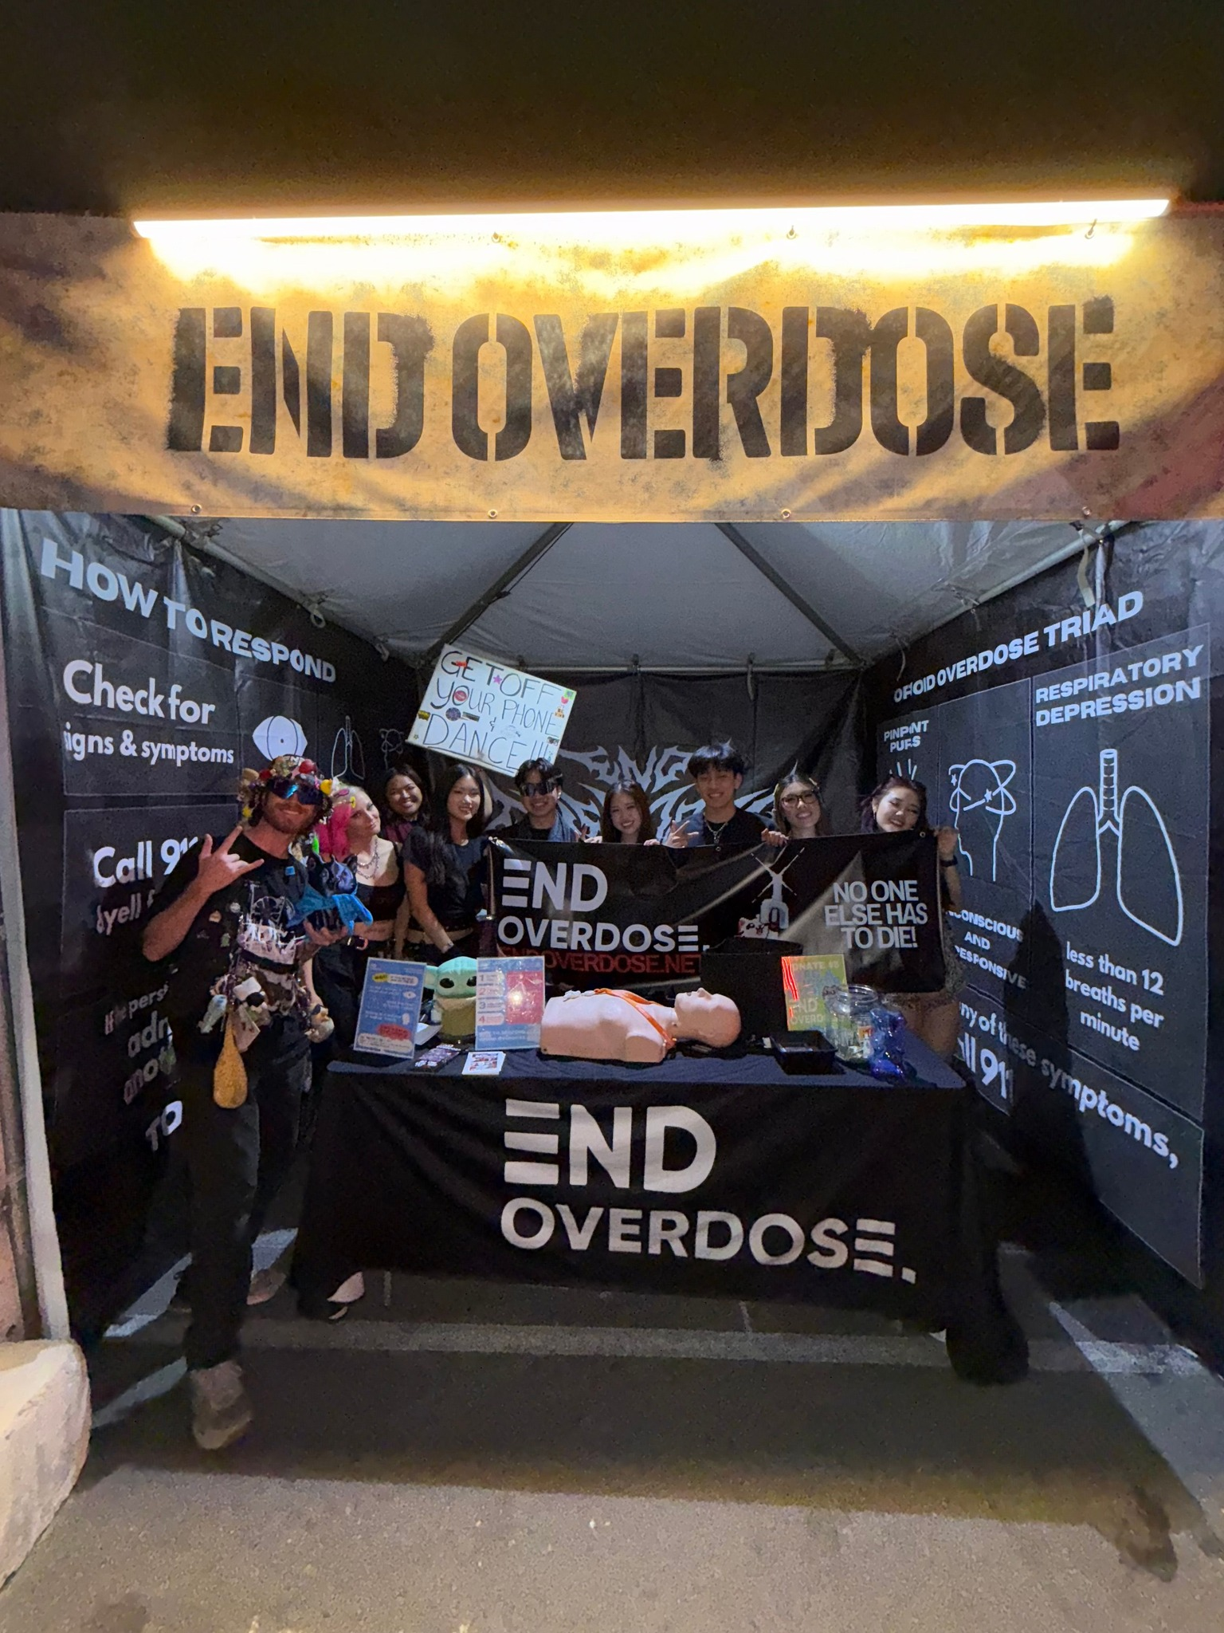
It empowers our students to help their peers!
They can take this with them and are certified via End Overdose.
Peer groups may be more open to their peers helping
They make it look cool!
https://www.facebook.com/reel/1181528127166683

Slide 26
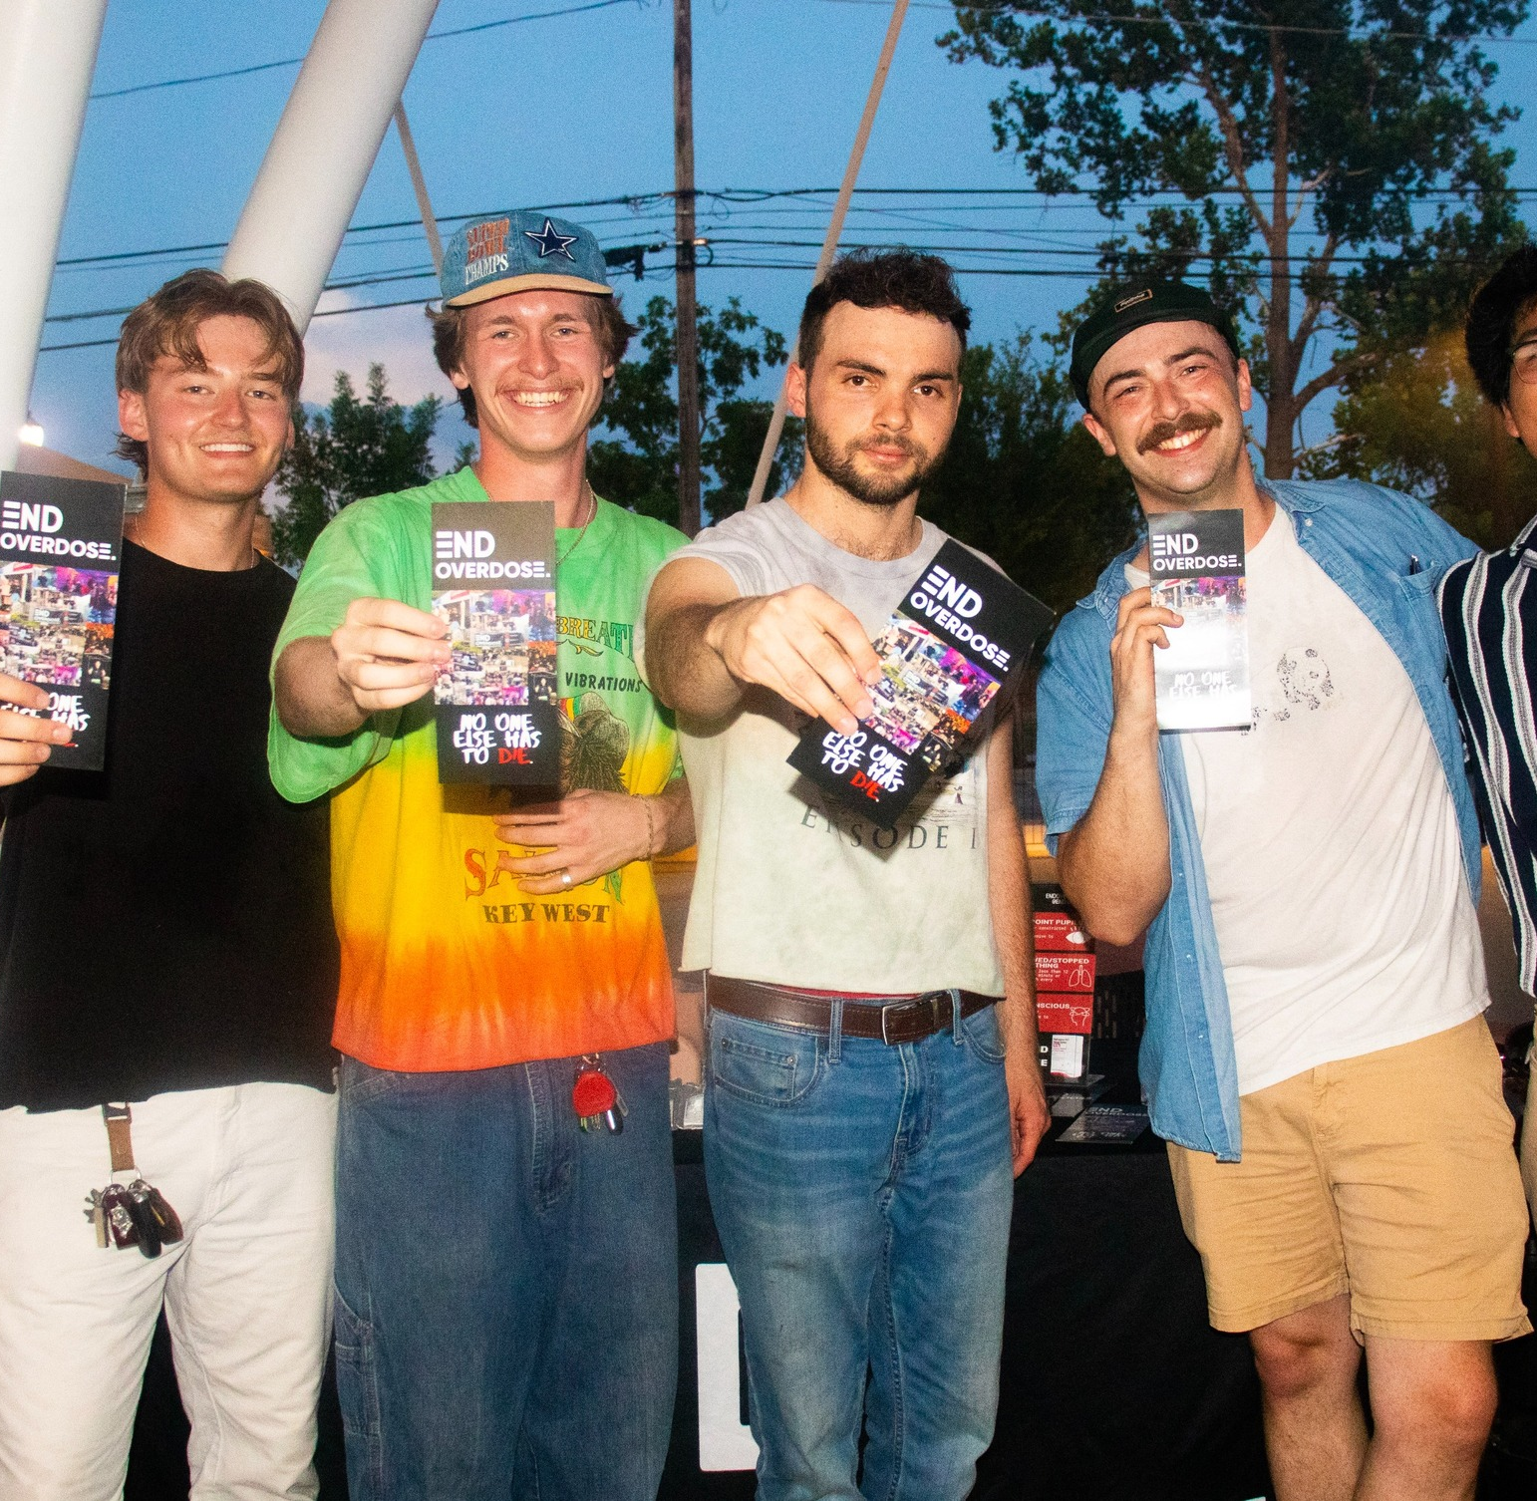
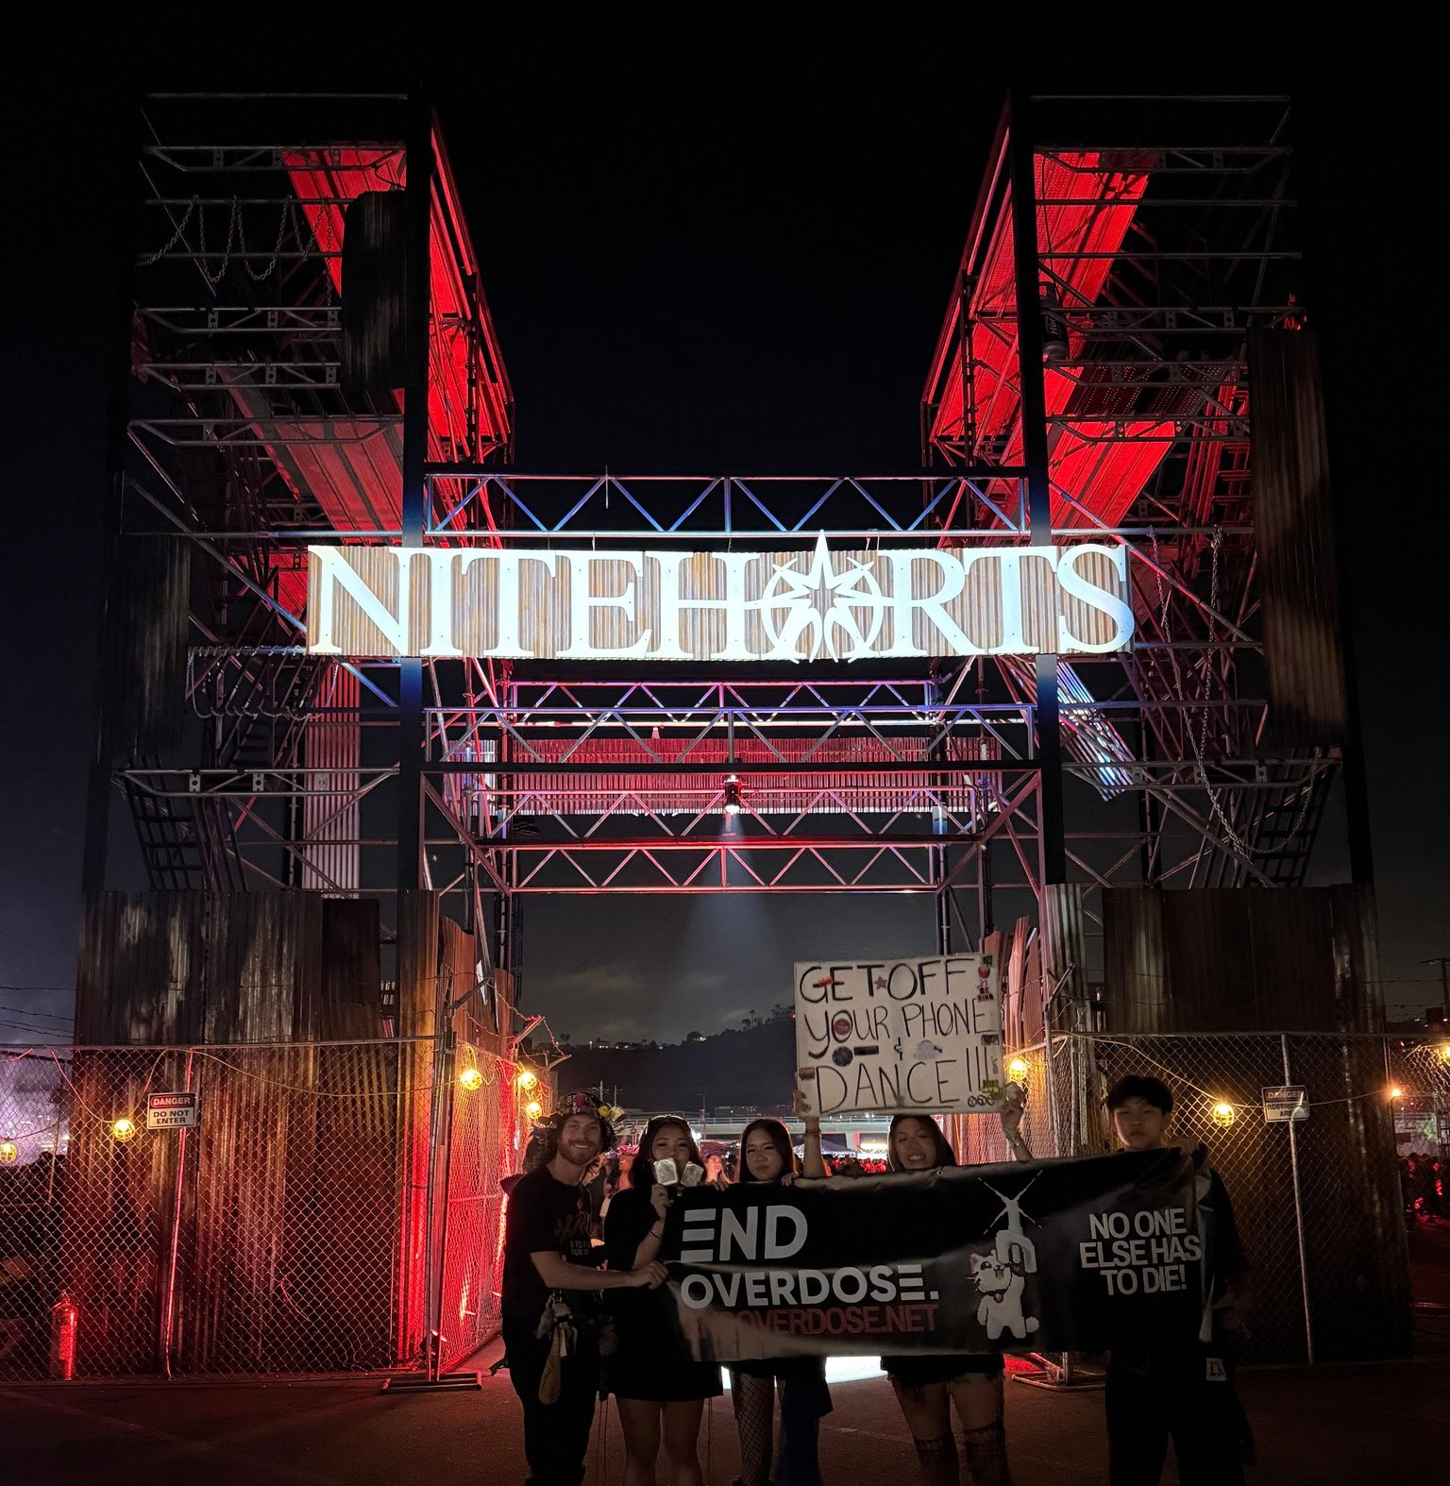
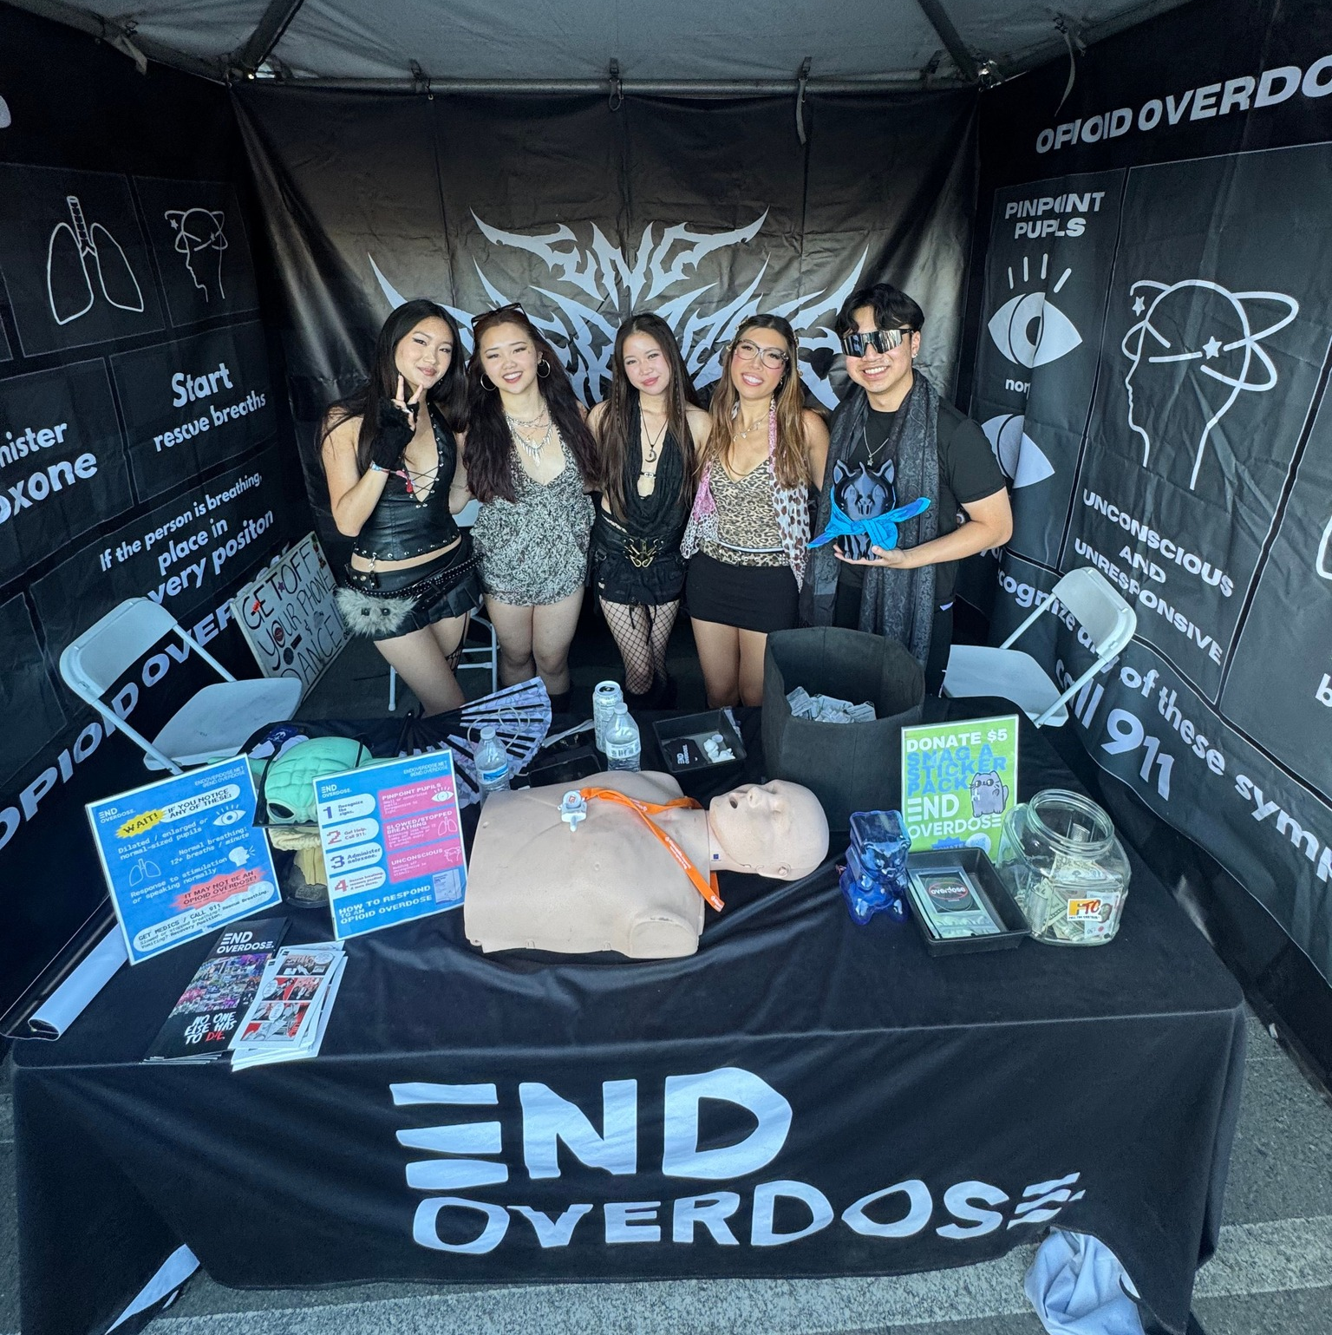
Applications open in April for new Chapters!
Be the FIRST campus in Illinois!!!!!

Slide 27
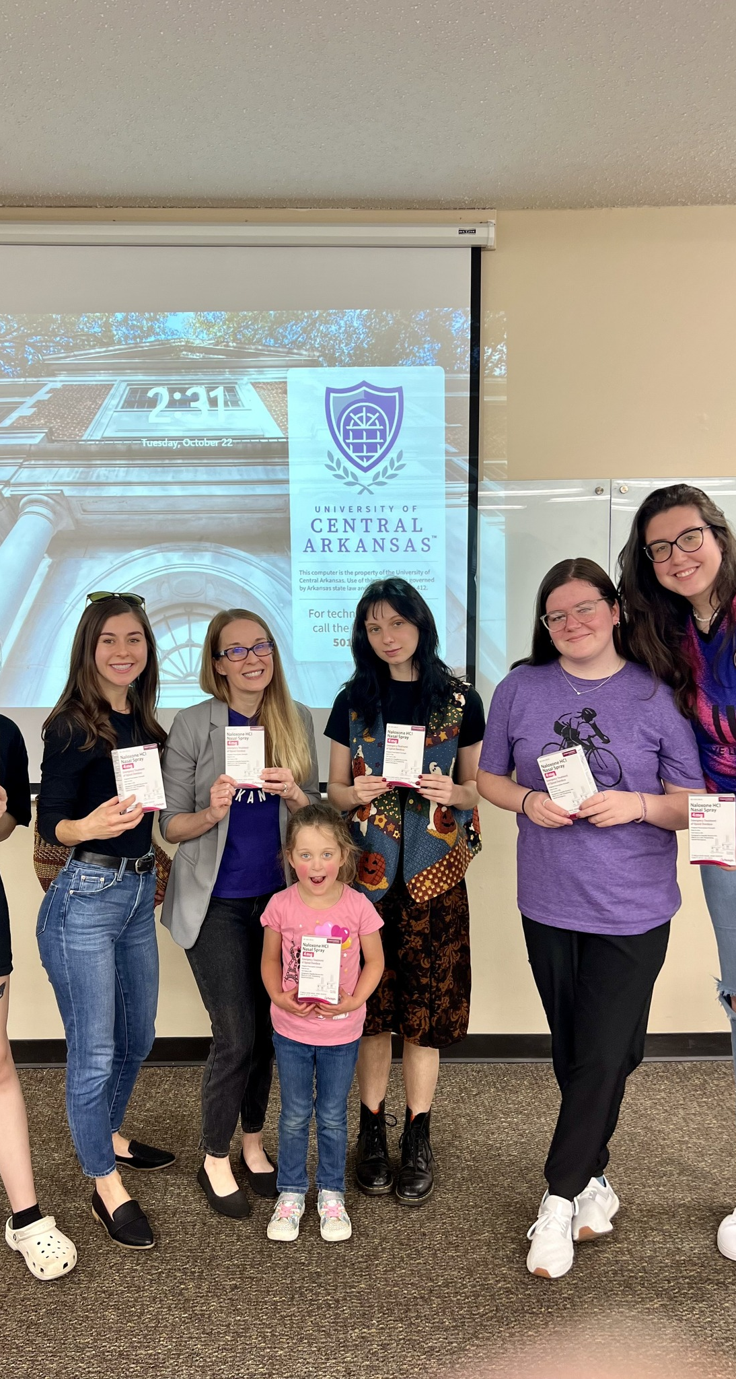
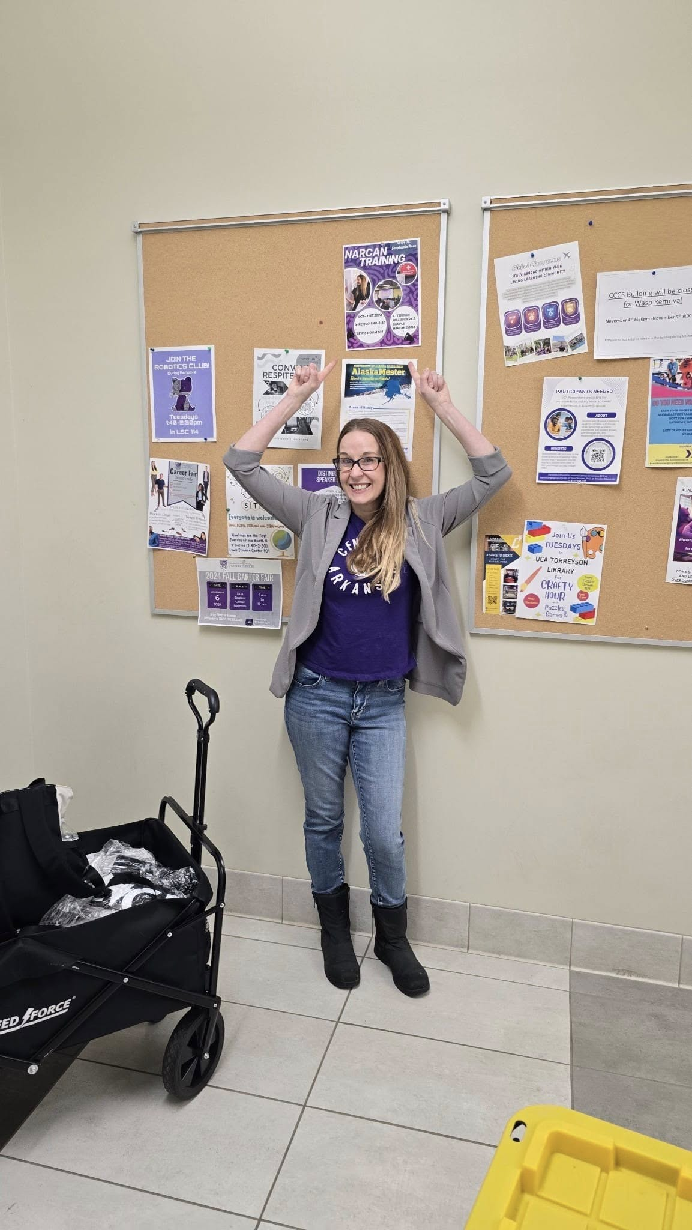
Questions and discussion?
srose3@uca.edu

Slide 28
References
Arkansas Opioid Recovery Partnership. (2024). Recover together. Retrieved October 18th from: https://www.arorp.org/
End Overdose. (2025). Our solution. Retrieved October 18th from: https://endoverdose.net/about/solution/
Illinois Department of Public Health. (2025). Opioid overdose reversal agents. Retrieved October 18th, 2025 from https://dph.illinois.gov/topics-services/opioids/overdose-reversal.html?utm

