Slide 1
Grow your own Peer Mentoring/support Program
Sauk Valley Community College Peer Mentor Program
Jennifer Hooker LCPC, LMFT

Slide 2
Introduction What connects me to Sauk

Slide 3
Introduction Learning Objectives
Learning Objective 1: participants will be able to explain the importance of having a peer mentoring/support program on their campus.
Learning Objective 2: participants will be able to identify at least three ways to measure success of a "Grow Your Own Peer Mentoring/Support Program."
Learning Objective 3: participants will be able to explain at least three barriers to implementing their own peer mentoring/support program on their campus.

Slide 4
Thinking beyond the Legislation

Slide 5
Healthy Minds survey continued

Slide 6
Loneliness
Increased before and after the pandemic
Approximately 39% of students ages 19-29-Gallup Web Survey 2430
https://www.gallup.com/education/509231/college-students-experience-high-levels- worry-stress.aspx
My observations at Sauk and previous experiences

Slide 7
Rural communities
Students will often wait to initiate counseling until college
Increase in demand for counseling
Wait times for both private practice and community mental health agencies can range from 6-8 weeks
Mentors to help fill the gap

Slide 10
The unknown of Covid
Trauma during covid and after
DCFS significant decrease in hotline calls
Are we thinking about it?

Slide 11
Summer/Fall 2020
M2 Peer Mentoring Model from Queen’s University in Canada
Started recruiting peer mentors in the Fall of 2020

Slide 12
Topics Covered
Time Management
Stress Management
Study Skills
Exam prep
Reading/Note taking strategies
Someone to listen

Slide 13
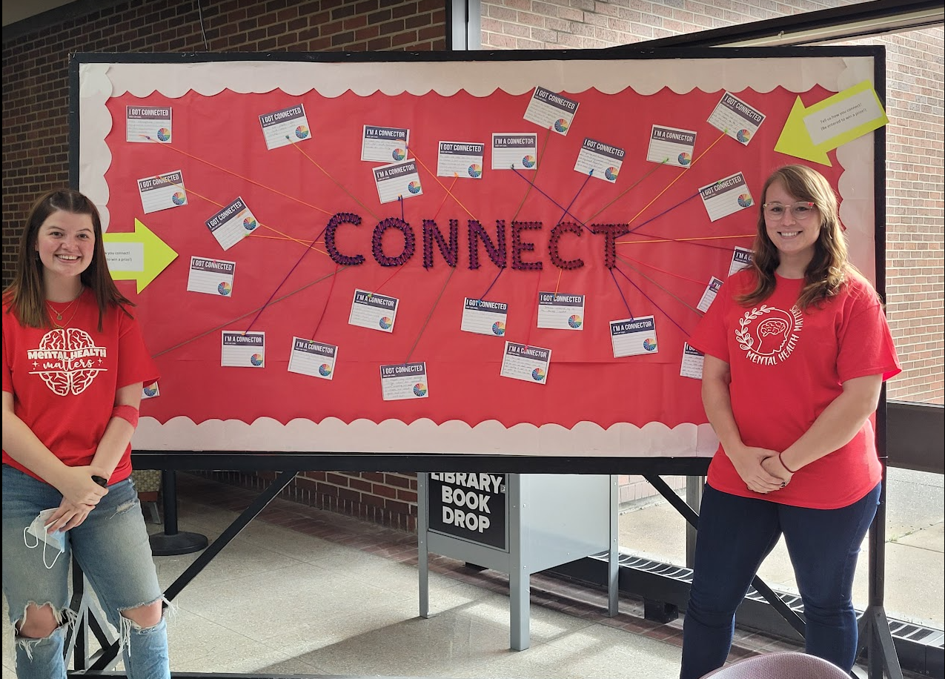
How I recruited
Sauk Scholars
Students stopping by for events

Slide 14
First training 3 Mentors

Slide 15
Sp 21/Great start!
We marketed ourselves to staff faculty and students
Started off strong:
3 staff referrals
6 student self-referrals
I provided weekly supervision /brainstorm ideas

Slide 16
Fall/Sp No Requests/What was the problem?
Faculty and staff aware of how to send students
01
Emails sent to students
02
The unknown
03
Limited time
04

Slide 17
Change needed Fall 2022
Developed Monthly Open Houses
Outreached personally to professors
Professors give extra credit
Posted flyers everywhere-students do not read email!
Increased signs pointing the way to our room

Slide 18
Our Journey Continued
Open House Examples:
SPRING 2023
February 21: Popcorn and movie
March 21: Pizza Party
April: Intro to Biology Study Group
April 20: Brinkley dog therapy
Excellent turnout, but no self referrals or students stopping by for open hours or requesting meetings

Slide 19
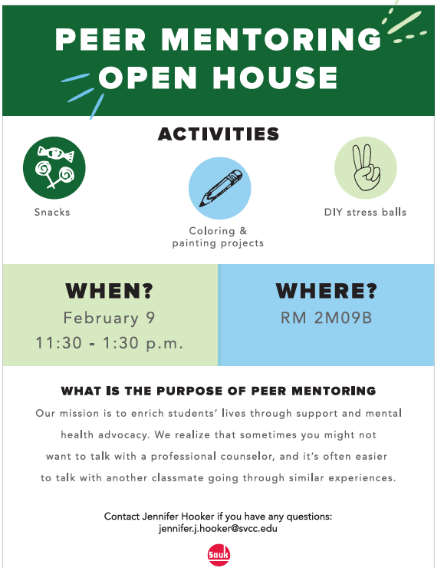
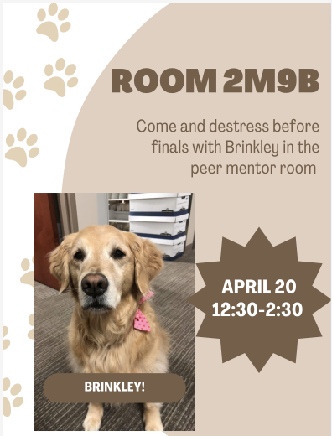
Examples of Open Houses

Slide 20
Changed Training to add MHFA
M2 Peer Mentoring is ongoing education

Slide 21
Fall 23
Hired a lead Peer Mentor who graduated last year
Pilot Peer Mentors with CSS 100

Slide 22
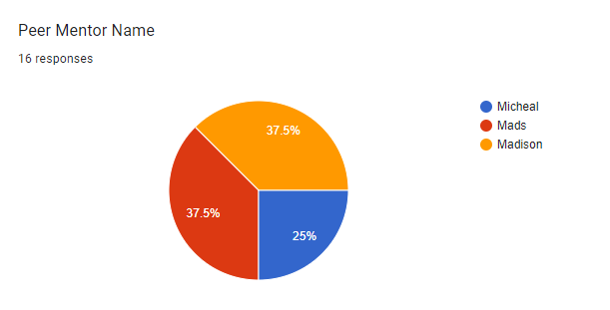
Fall 2023
Piloted College Success Skills with Mandy Aldridge

Slide 23
CSS 100 Pilot
Mentors emailed students every 2 weeks
Points assigned by professor/excel spreadsheet mentors documented
Emails from mentors related to material learning and sharing their own experiences
Students had to respond to email prompts on topics to improve insight and success
Students often responded more than required with their assigned mentor

Slide 24
# of Students
Level of Comfort with Mentor

Slide 26
6.3%

Slide 28
Based on Requests from Questionnaire Plan for Spring 2024
Added Options:
Professor/Vice President involvement
Bi-Weekly Check-in emails
01
One on one meetings when student is available
02
Video/Phone calls
03

Slide 29
Additional Initiatives Spring 24
First Week of Class:
Help new students struggling with logging into their accounts
Assist understanding Canvas

Slide 30
Example:

Slide 33
Success!
7 Students requested mentoring
3 or 4 students regularly stop by during open hours and the others requested email contact.

Slide 34
Goals for Fall 2024
Continue awareness of who we are and offer help during stressful times of the semester
Develop a consistent curriculum for future mentors to use with mentees
Study groups with professor input
Monthly open houses
Redesign our space

Slide 35
SVCC Peer Mentor Logo

Slide 36
Integration into FYE Pilot
Students receive extra credit points from FYE instructor if they “opt in or opt out” of peer mentoring 2X’s during the semester
Align with course material
Pre-planned email topics
Email 1 (Week of September 3)
Mentors share their own experiences
of being a new student and give helpful
tips

Slide 37
Examples Continued
Email 3 (Week of September 30)
Study tips and tricks VIDEO
Writing, reading, making quizlets, flash cards, create a study group
Email 4 (Week of October 14)
Good luck on midterms Stress Management
Provide link to Calm/timely and include one of your favorite calm video/audios

Slide 38
3rd Spaces
Consulted with Erin Peavy: architect and design researcher
Combines psychology with architecture.
“Create spaces that foster connection”
UC San Diego: students reported “improvements in connectedness and reduction in depression”
Met with Erin

Slide 39
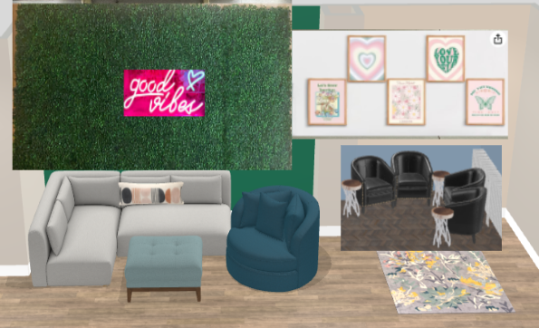
Inside the Peer Mentor Room

Slide 41
Peer Mentor Video
https://drive.google.com/file/d/1kYCksU7nQS18sz6wTrBB-u1rfXU4vzcV/view

Slide 42
SVCC Peer Mentor Website
svcc.edu/peermentoring
svcc.edu/BeAMentor

Slide 43
What I’ve learned

Slide 44
Create Small Opportunities to connect
Engage students with secondary concerns
For example:
1st week of classes
Understanding how to register
Study groups
Consistent open hours

Slide 45
Best Student Turnout! Students shared their own stories Natural conversation Around peers that are supportive

Slide 46
Ideas for Future Assistance- It takes a Village!
Team Approach: Don’t do it alone
Trio
Majority of mental health referrals
Collaborate with Trio staff
Make a team of 2-3 people to build and monitor program
Share training responsibilities
Consider a paid Lead Peer Mentor

Slide 47
Recruitment ideas
Student clubs: Phi Theta Kapa, Student Government, Rotaract
Targeted recruitment: human service field and education
Reach out to professors about referrals of prospective mentors
M2 suggests a $500 scholarship
Beyond my scope: COD offers MHFA as a 1 credit class. Consider combining MHFA with M2 Peer Mentoring/Personal Health and Dev

Slide 48
Tips
Have a consistent agenda each semester
Make a logo for the peer mentors/get assistance from student marketing
Assist mentors in formatting consistent messages to students
Create small opportunities
Create personal emails to professors

Slide 49
Tips Continued
Visible at student events
Monthly events in peer mentor room-giveaways
Give students more than one way to connect to mentors
What helps your students connect? Virtual system pros and cons

Slide 50
Systemic Approach

Slide 51
Faculty/Staff Wellness
Presentations to Faculty/Staff (Example)
Burnout
Their mental health and students
Compassion to self and students
Setting appropriate boundaries
Guided meditations during covid
Faculty, staff and students access to CALM
Future Goals
Faculty/staff open hours consultation-student success committee

Slide 52
Outreach: Student Wellness
Presented Trio Students
Peaceful place
Self compassion
Presentations to Adult Ed
Ways to manage stress and college
Mental health
Overcoming challenges
Mental Health First Aid
General student interest
ADN program

Slide 53
Any questions?

Slide 54
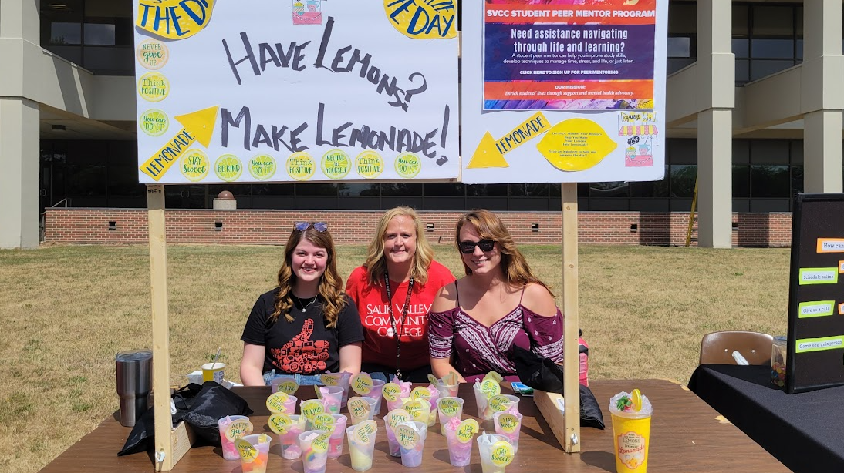
Fall of 21
SaukFest

Slide 55
MENTAL HEALTH DAY!

Slide 56
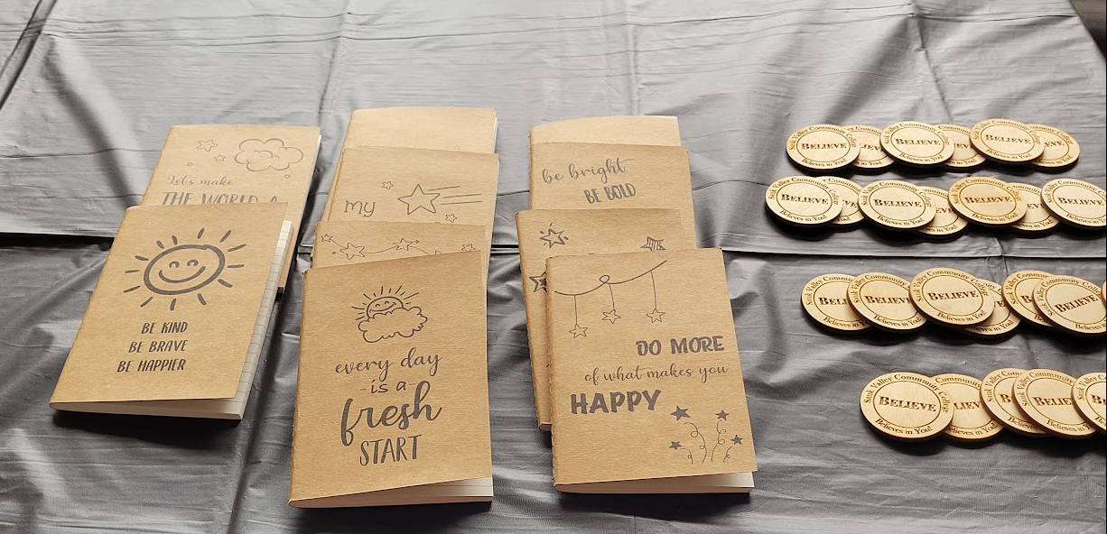
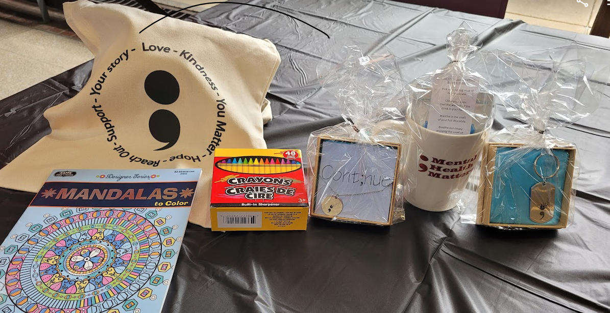
Student Giveaway ideas:

Slide 57
Peer Mentor Activities

Slide 58
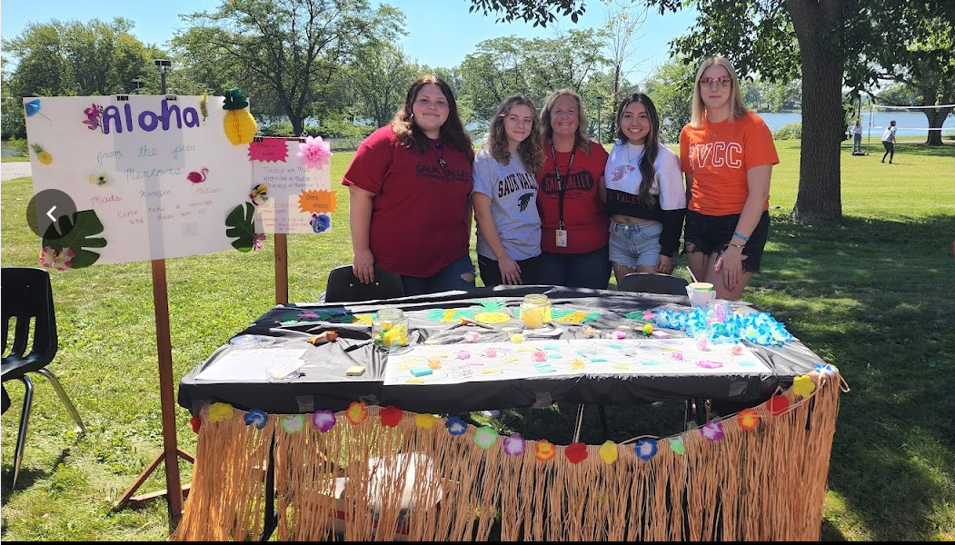
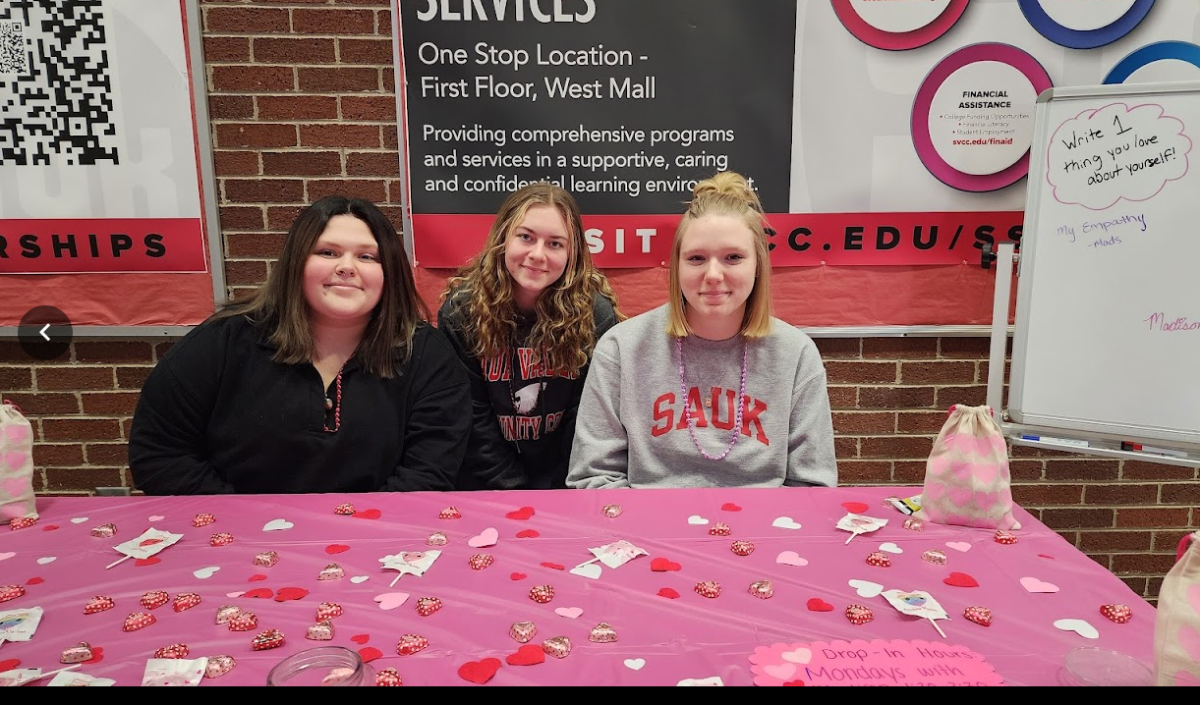
SaukFest

Slide 59
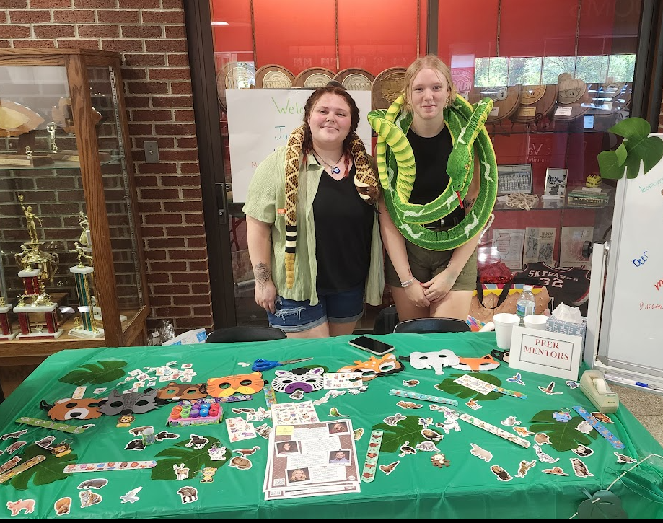
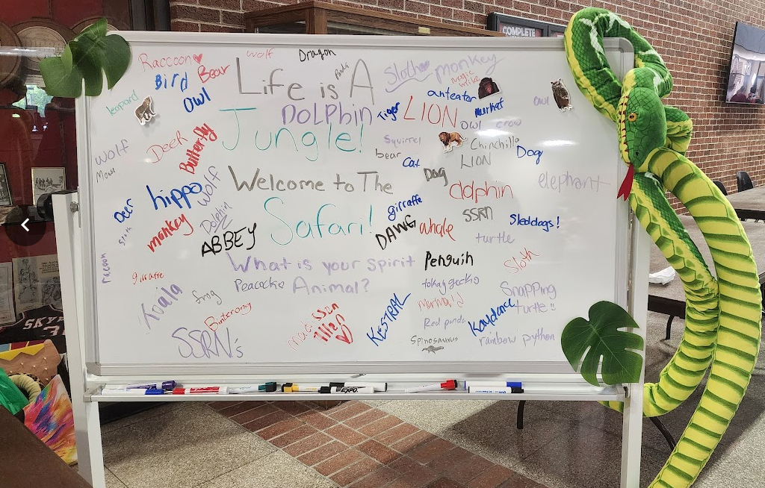
SaukFest

Slide 60
Additional information
Peer Mentor Activity Log: https://forms.gle/yyqpGPvQ7FTEAG9g9
Peer Mentor Eval from CSS 100 end of term: https://forms.gle/o3iYBApUasQaiZH68
Peer Mentor Sign-up: https://forms.gle/ZFFm3m89CywWnkCh6
Mentor Satisfaction Survey for training: Align course objectives with survey
Wellness Assessment from M2 Peer Mentoring Manual: https://forms.gle/xoXbBSKnoPYj1uC9A
Mentee Satisfaction Survey/General: https://forms.gle/UQPLyQ1PVTpzRt2BA

